Slide 1
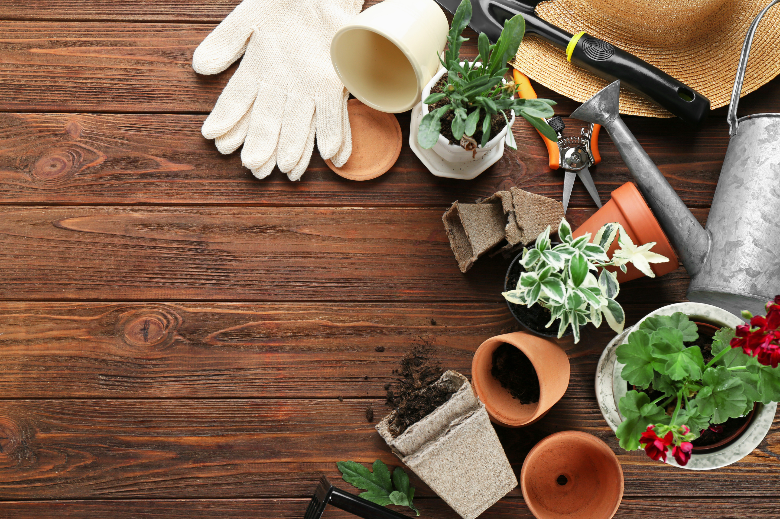
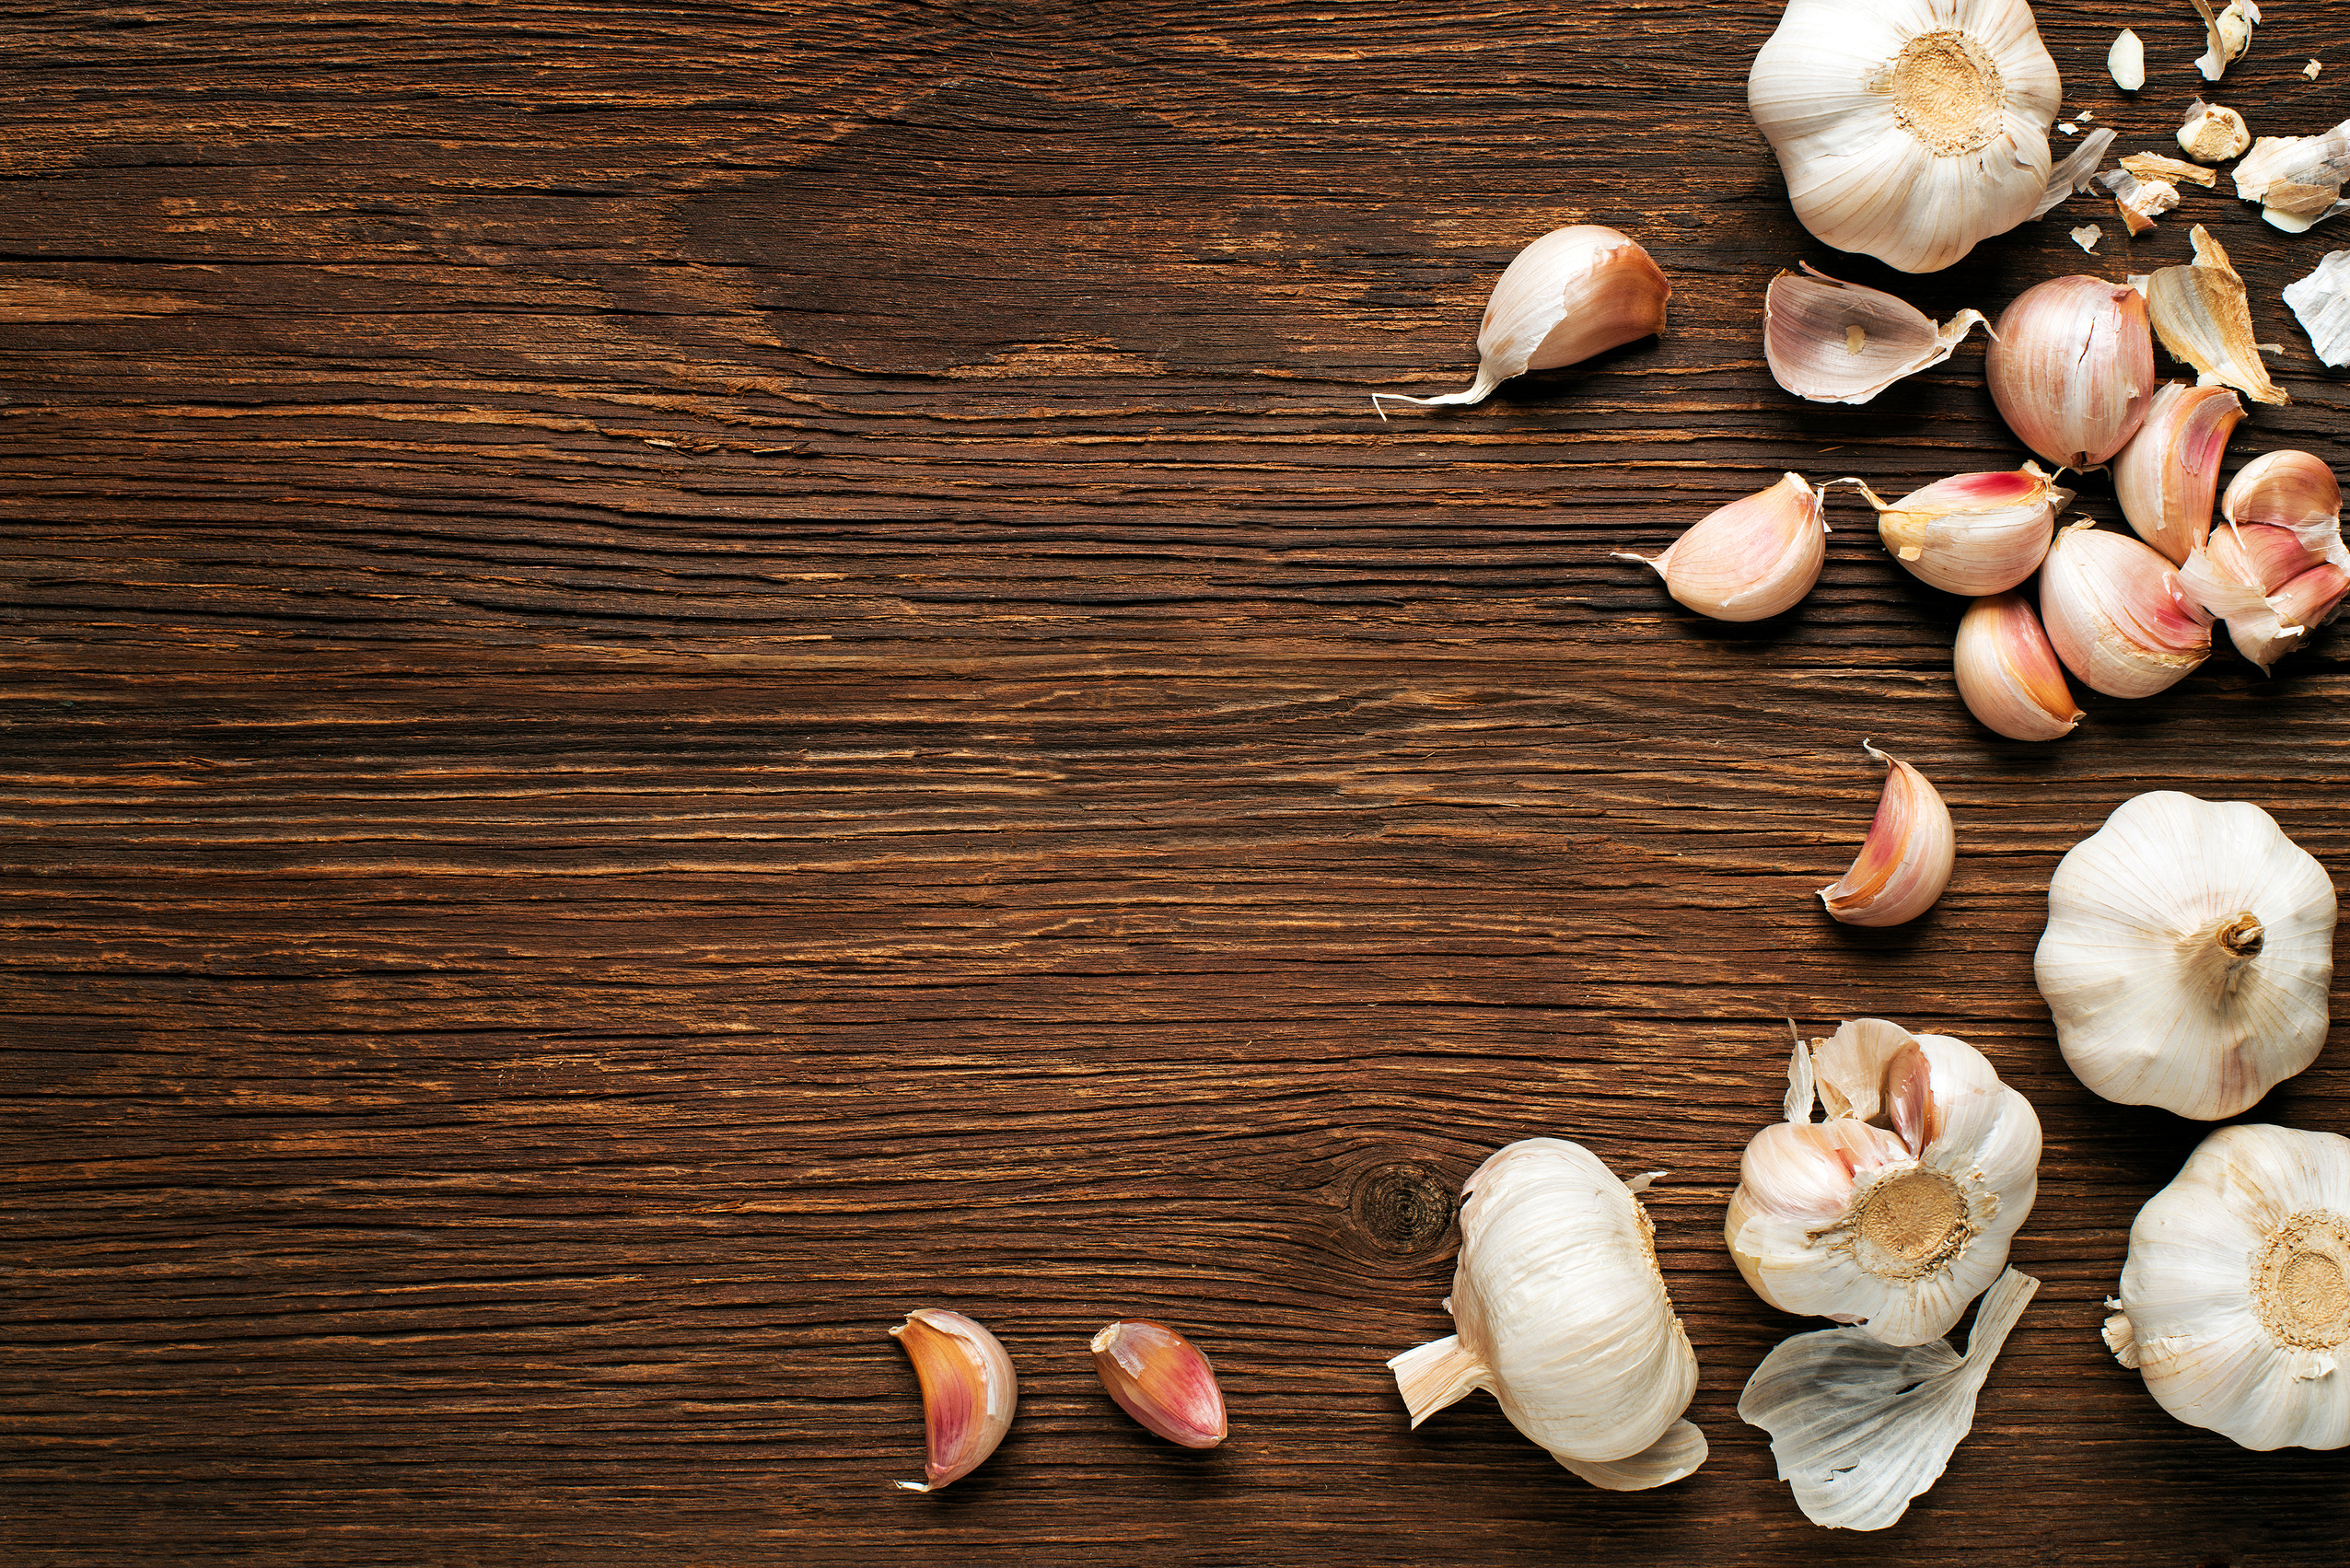

GARDEN
Revolution
GARLIC CULTIVATION

Slide 2
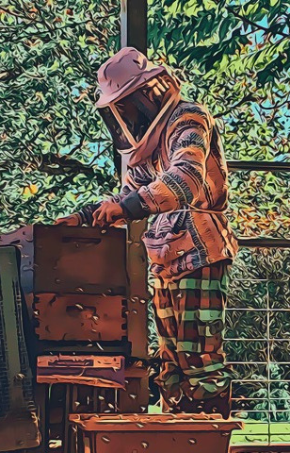
I'm a Master Gardener, Gardening Life Coach, and a Farmer/Rancher in Appalachia. With a passion for sustainable living and over a decade of experience, I've dedicated my life to enhancing ecological awareness and community empowerment. Join me in exploring how we can create a more sustainable future together.
  Bee Keeping
  Herbalism
  Wildcrafting
  Foraging
  Animals Husbandry
  Master Gardener (VA / WV)
  Master Permaculturalist
  Gardening Coaching
  25+ Years Raising Chickens
  Alchemist
  Life Navigation Coach
  Healer
MASTER
PERMACULTURALIST
MASTER
GARDENER

Slide 3





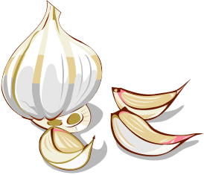
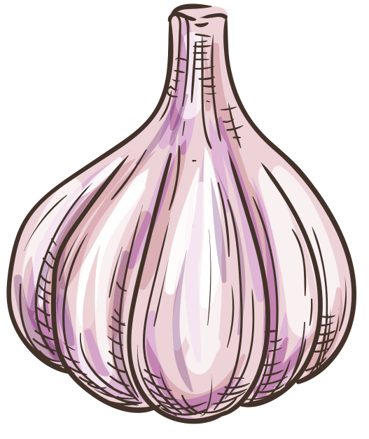

Types of Garlic
Softneck
Hardneck
Elephant
Mild-flavored with flexible stems, ideal for braiding and long storage (up to 9 months). Best suited for warmer climates..
Strong, robust flavor with a stiff stem and produces edible scapes. Perfect for colder climates but has a shorter storage life (4-6 months).
Large, mild-flavored cloves, more closely related to leeks. Takes two years to mature but yields impressive bulb sizes.

Slide 4

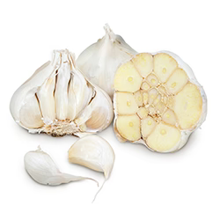

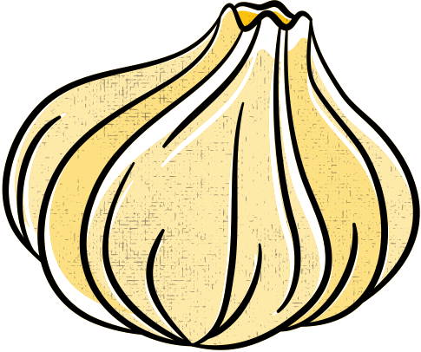
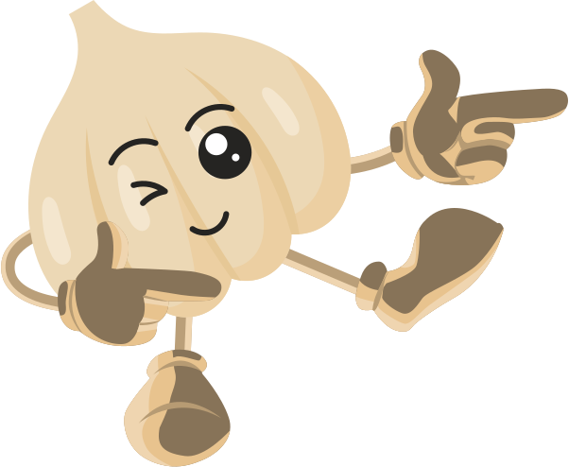
Softneck

Slide 5
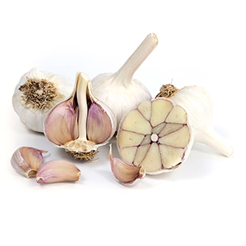
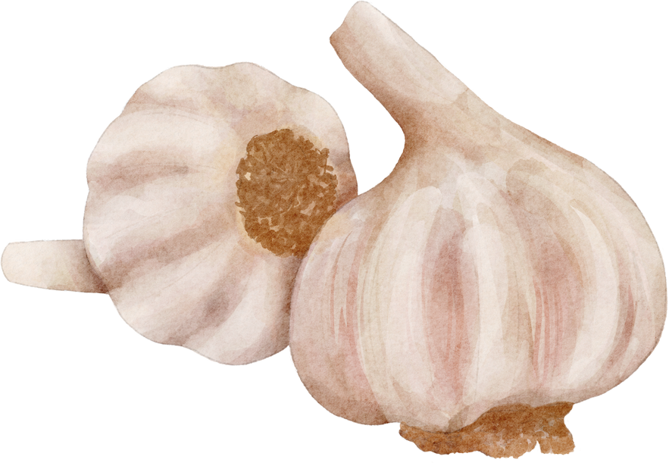
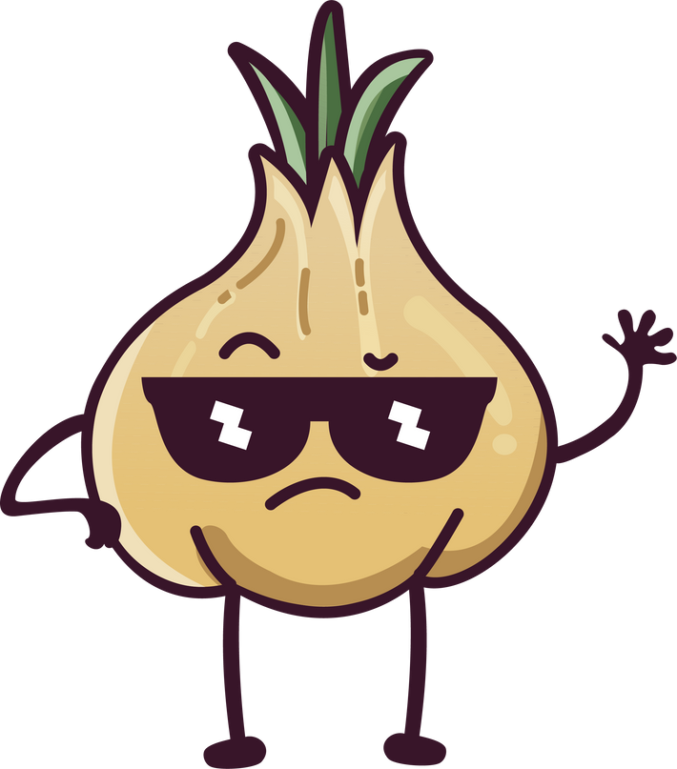
Hardneck

Slide 6


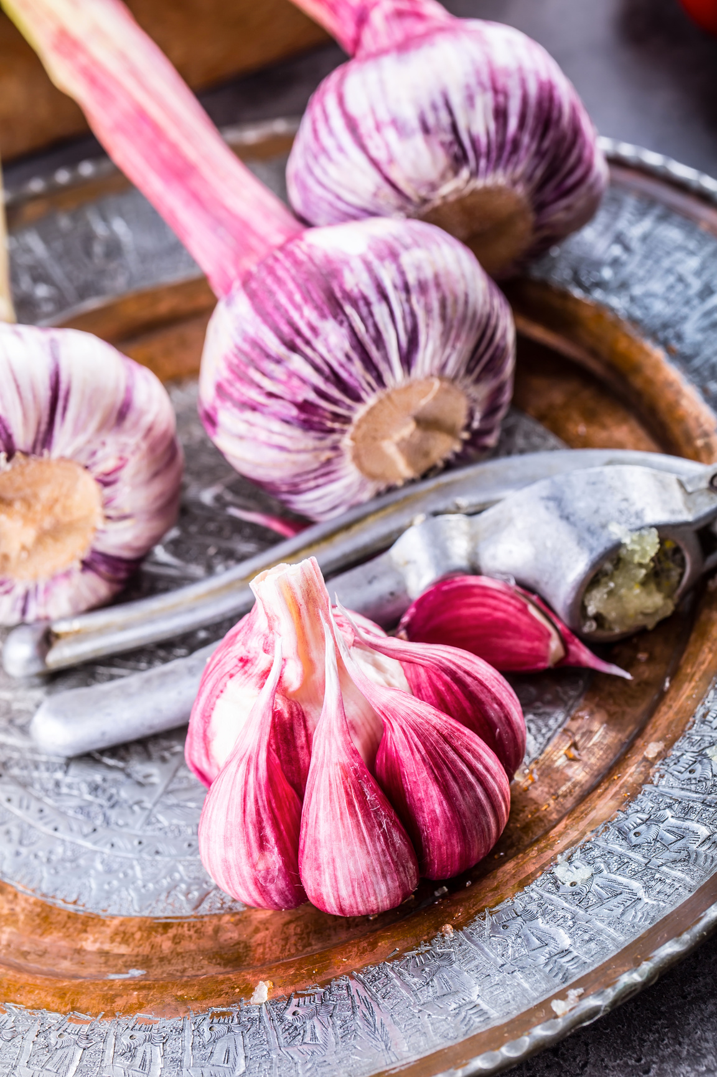

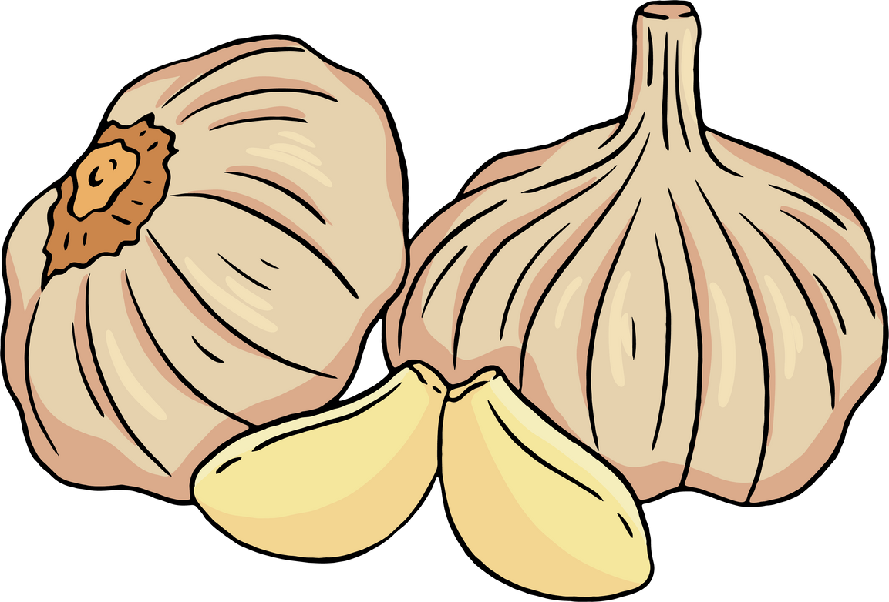

Sunlight and Soil –
What Garlic Needs to Thrive
  Full sun (6-8 hours a day) is critical for bulb development.
  Well-draining, loose soil is essential—work in plenty of compost.
  Nitrogen-rich fertilizer helps boost leaf growth for larger bulbs.

Slide 7

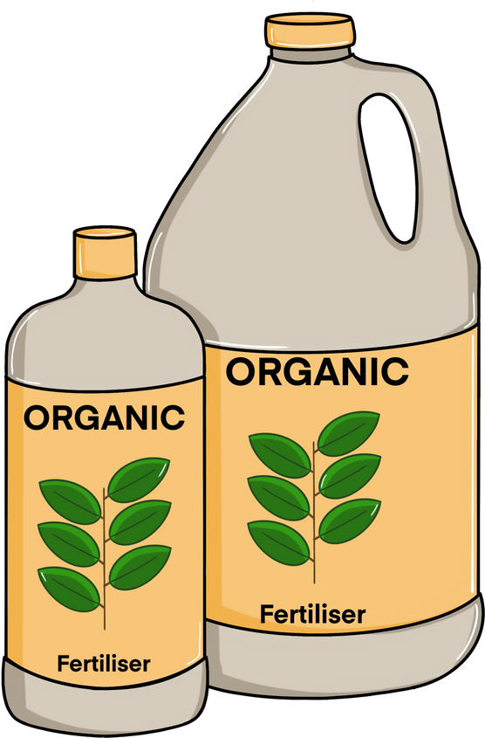

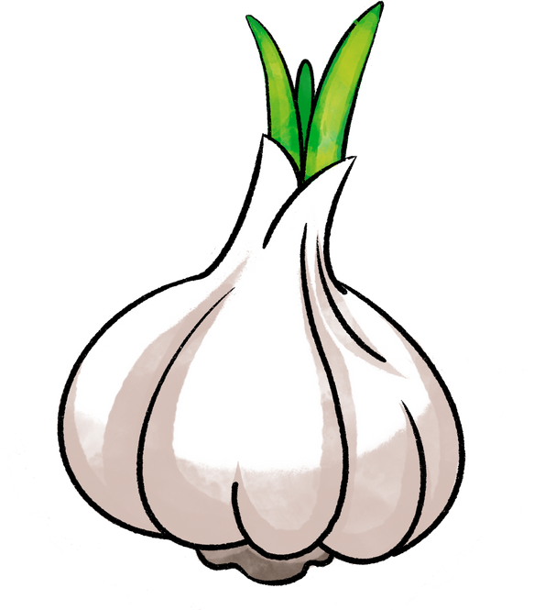
Preparing the Soil
  Clear debris (weeds, rocks), loosen soil (8-12 inches deep).
  Amend soil with compost and nitrogen-rich fertilizer (blood meal).
  Crop rotation: Rotate garlic to prevent disease buildup and improve soil fertility.

Slide 8
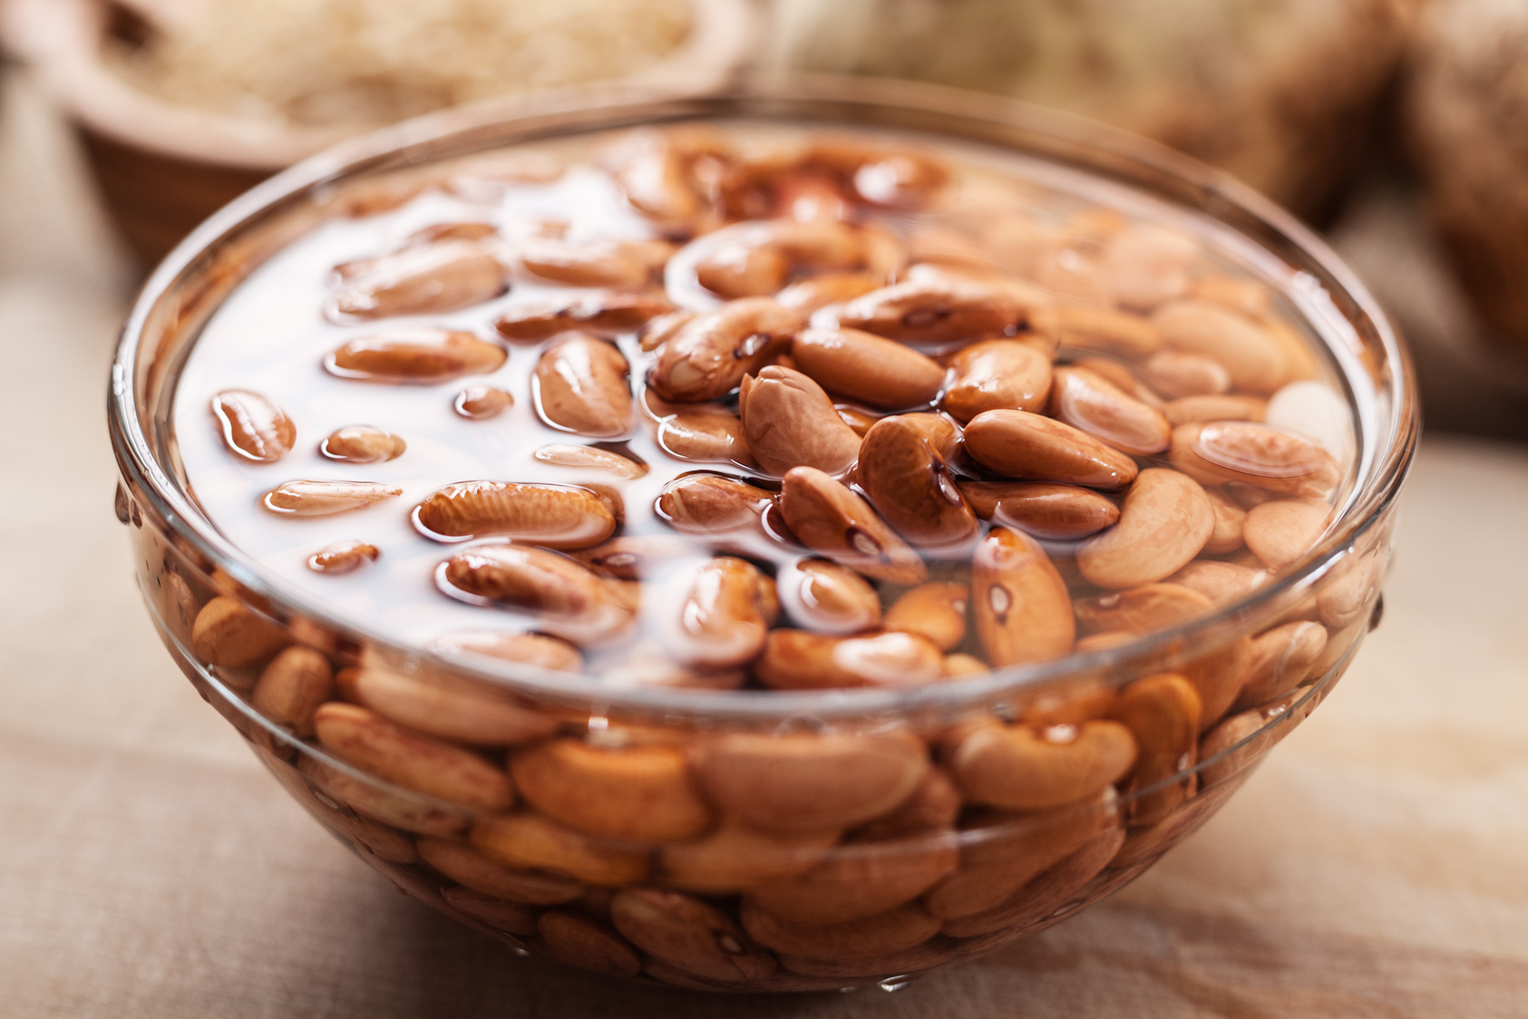
Selecting and Soaking Cloves
When selecting your cloves, go for the biggest, healthiest cloves you can find. The bigger the clove, the bigger the bulb it will produce. Avoid any cloves that are damaged, soft, or showing signs of disease, as these can lead to poor growth or even infect your soil.
Soaking helps prevent fungal and bacterial diseases and promotes faster root development.
Here’s a simple soaking solution I use:
  A teaspoon of baking soda to fight off fungal infections.
  A splash of liquid kelp, which provides a nutrient boost to encourage root growth.

Slide 9
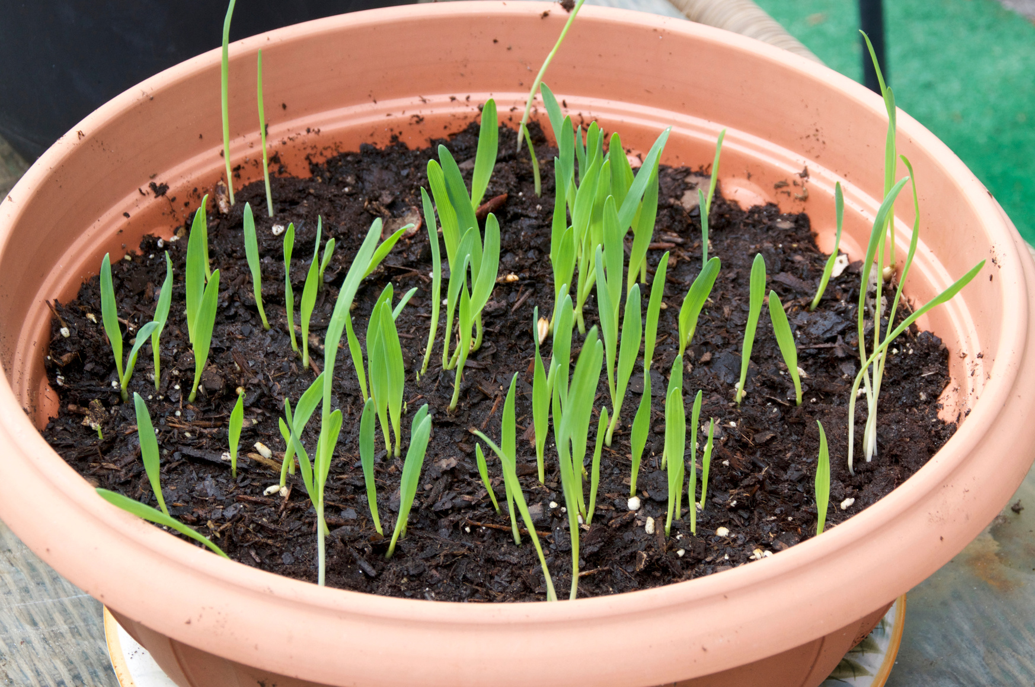
Correct Orientation
and Spacing
The flat root end down. The pointy end is where the shoot will emerge, and the flat end is where the roots will grow, so this orientation is critical for proper growth.
In terms of spacing, here’s what I recommend:
  For softneck and hardneck garlic, space the cloves 4-6 inches apart.
  If you’re planting elephant garlic, give it a little more room with about 6-8 inches of spacing between cloves.
After planting, cover the cloves with about 2 inches of soil and then apply a layer of mulch—more on that later."

Slide 10
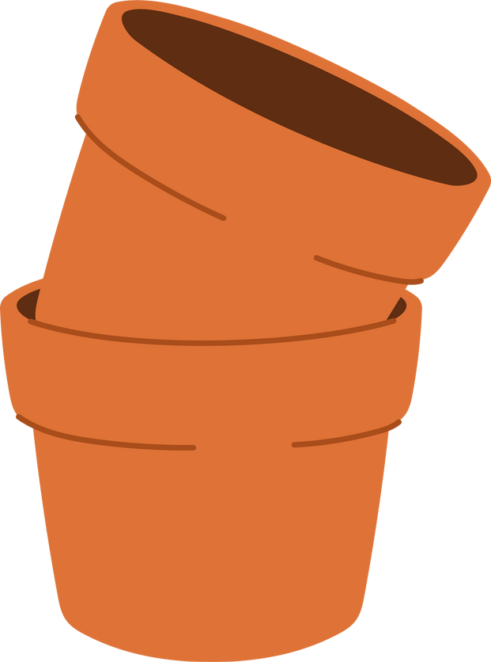
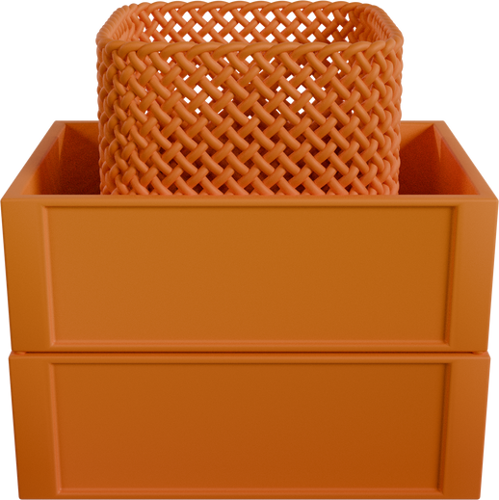
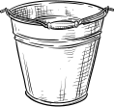
Why Grow Garlic in Containers?
Predictable Growth Pattern:
Space Efficiency:
Low Maintenance
Containers allow you to grow garlic in limited areas like patios or balconies.
It doesn’t need constant attention once planted.
Garlic grows in a controlled and predictable manner, making it easy to manage in small spaces.

Slide 11
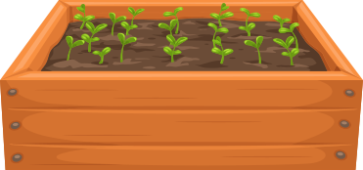
Container Considerations
Space:
  Maintain the recommended 4-6 inch spacing between bulbs, using single-file or circular arrangements in containers.
Temperature:
  Containers are more susceptible to temperature swings, especially in cold or hot climates.
Moisture:
  Containers drain faster than garden beds, meaning garlic in pots needs more frequent watering.
  Key Tip: Keep soil slightly moist but never soggy to avoid rot.

Slide 12
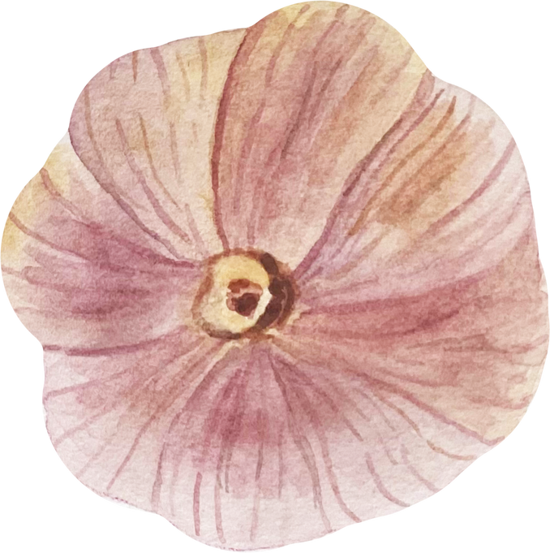

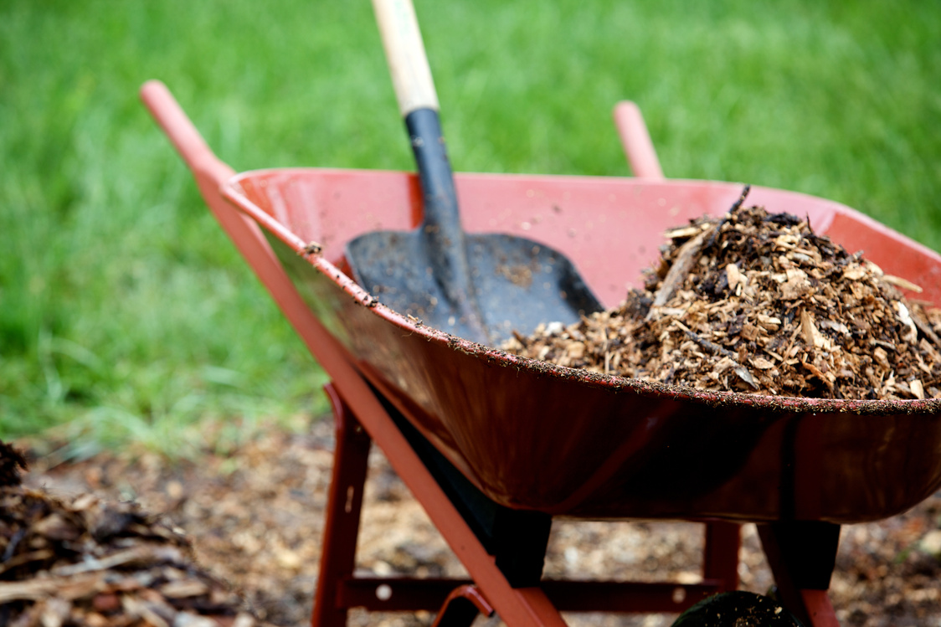
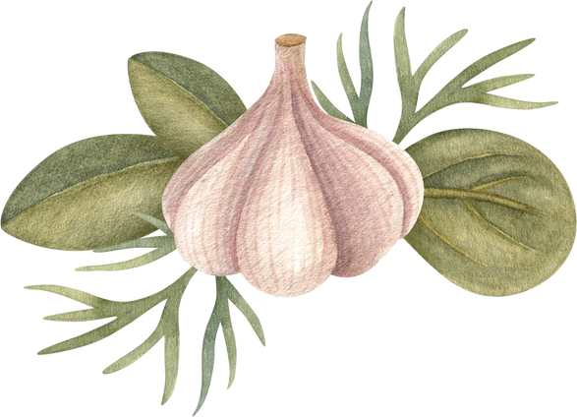
The Importance of Mulching
  Leaves: If you’ve got trees nearby, fallen leaves are an easy, free option.
  Grass clippings: Make sure they’re dried out first to avoid matting.
  Straw: This is one of the best mulches for garlic—it’s lightweight,
  provides great insulation, and breaks down nicely to add organic matter to the soil.
Mulch
Mulching serves two main purposes. First, it helps retain moisture in the soil, keeping it from drying out during the winter months. More importantly, it protects the garlic from frost heaving, which happens when the soil freezes and thaws repeatedly. This can actually push the garlic cloves out of the ground, exposing them to the elements and damaging the roots. A thick layer of mulch—around 4-6 inches—is a great way to prevent this.

Slide 13
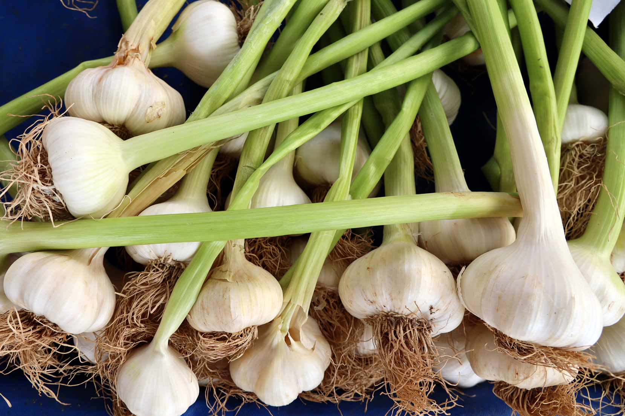
When and How to Harvest
  When to harvest: 40-50% of leaves are yellow/brown.
  How to harvest: Loosen soil with a fork, lift gently, and don’t wash the bulbs—leave the soil on until curing.
    There are wild garlic varieties, such as ramps (Allium tricoccum), which grow naturally in certain regions. These wild types are often foraged in early spring and have a distinct, pungent flavor, making them a sought-after ingredient in gourmet cooking. Ramps and other wild garlic types are popular for their early availability and strong garlic-like taste.

Slide 14
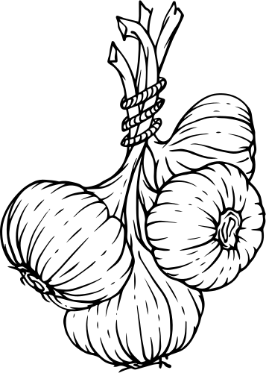
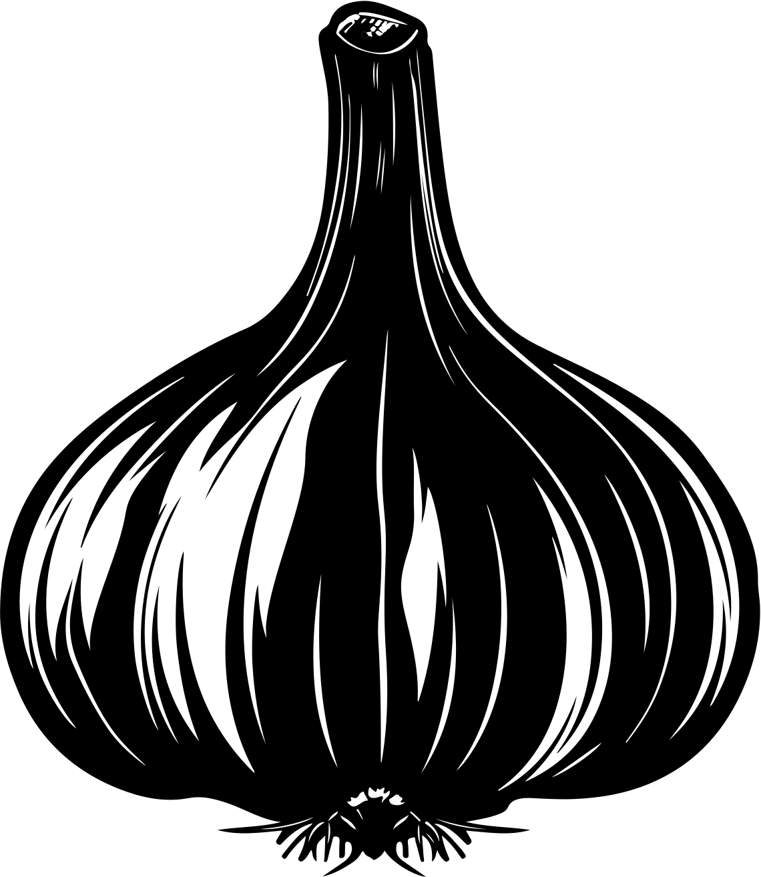
Curing and Storing Garlic
  Cure for 2-3 weeks in a well-ventilated area (bundle or lay flat).
  Store in a cool, dry place (pantry or basement).
  Avoid plastic or airtight containers.
  Storage life: Softneck: 9 months, Hardneck: 4-6 months.

Slide 15

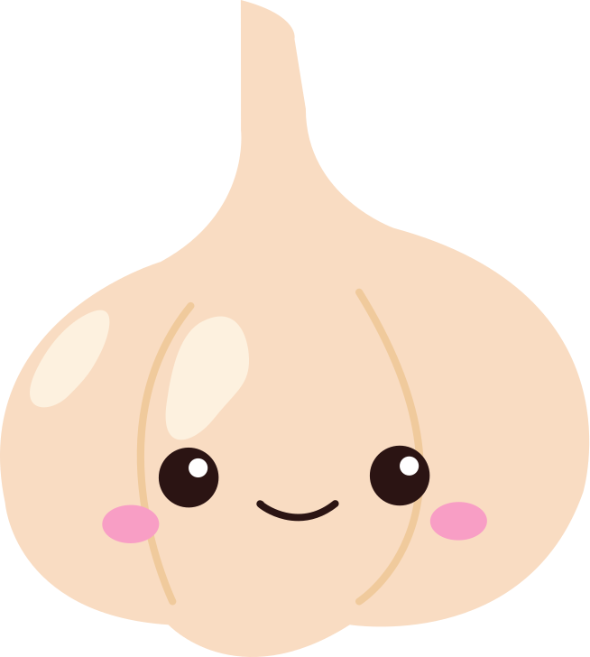
TroubleShooting
Poor bulb formation:
Fungal
diseases:
Yellowing leaves:
Organic solutions:
Due to lack of sun, late planting, or insufficient nutrients
Use crop rotation and well-drained soil. Avoid overhead watering.
Caused by nitrogen deficiency or overwatering.
Healthy, compost-rich soil, proper watering, and crop rotation..

Slide 16
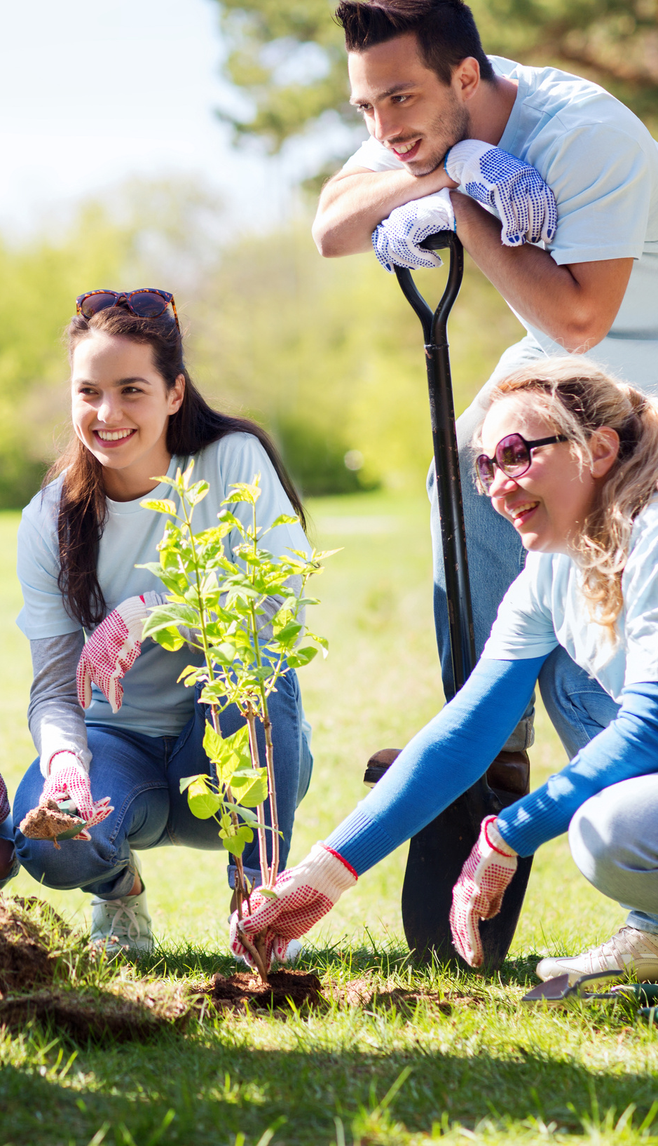

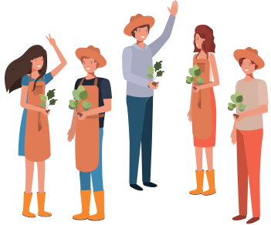

WHERE
TO CONTINUE LEARNING
Local Gardening Clubs: These clubs are like gold mines of knowledge and experience. You get to connect with folks who've been tilling and toiling, and who know the local soil and climate like the back of their hand. Plus, it's a wonderful way to build friendships rooted in a shared love for gardening.
Online Forums and Groups: These virtual communities are amazing for getting speedy answers to your gardening queries, sharing the joys of your garden's progress, and even finding humor in the occasional hiccups. It's a space where you can feel connected with fellow garden enthusiasts from all over the globe, regardless of where you are

Slide 17


xDoc’s IRL Class
Sustainable Garden Series at Craft Memorial Library: And here's something special for you – I personally teach classes once a month at the Craft Memorial Library in Bluefield, WV, as part of the Sustainable Garden Series. It's a fantastic opportunity to learn, share, and grow together in our understanding of sustainable gardening practices.
mavisfarmacy.com

Slide 18
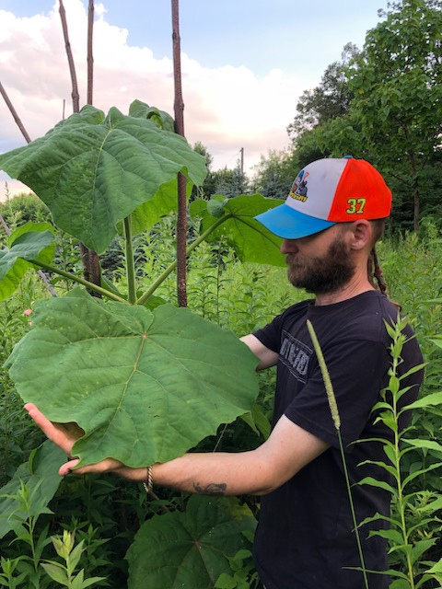
xDoc’s Online Class
Tailored Learning Experience: Alongside the lively discussions on our Discord channel, I also offer private gardening lessons online. These sessions are designed to cater specifically to your gardening interests and challenges. Whether you're a beginner needing foundational advice or an experienced gardener facing unique obstacles, these lessons provide personalized guidance to ensure your garden thrives.
Get in Touch for Customized Guidance: Interested in taking your gardening skills to the next level with some personalized coaching? Feel free to reach out to me at MavisFarmacy@gmail.com. I'll be more than happy to work with you one-on-one, helping you navigate the joys and challenges of gardening in a way that’s customized just for you.
www.mavisfarmacy.com

Slide 19

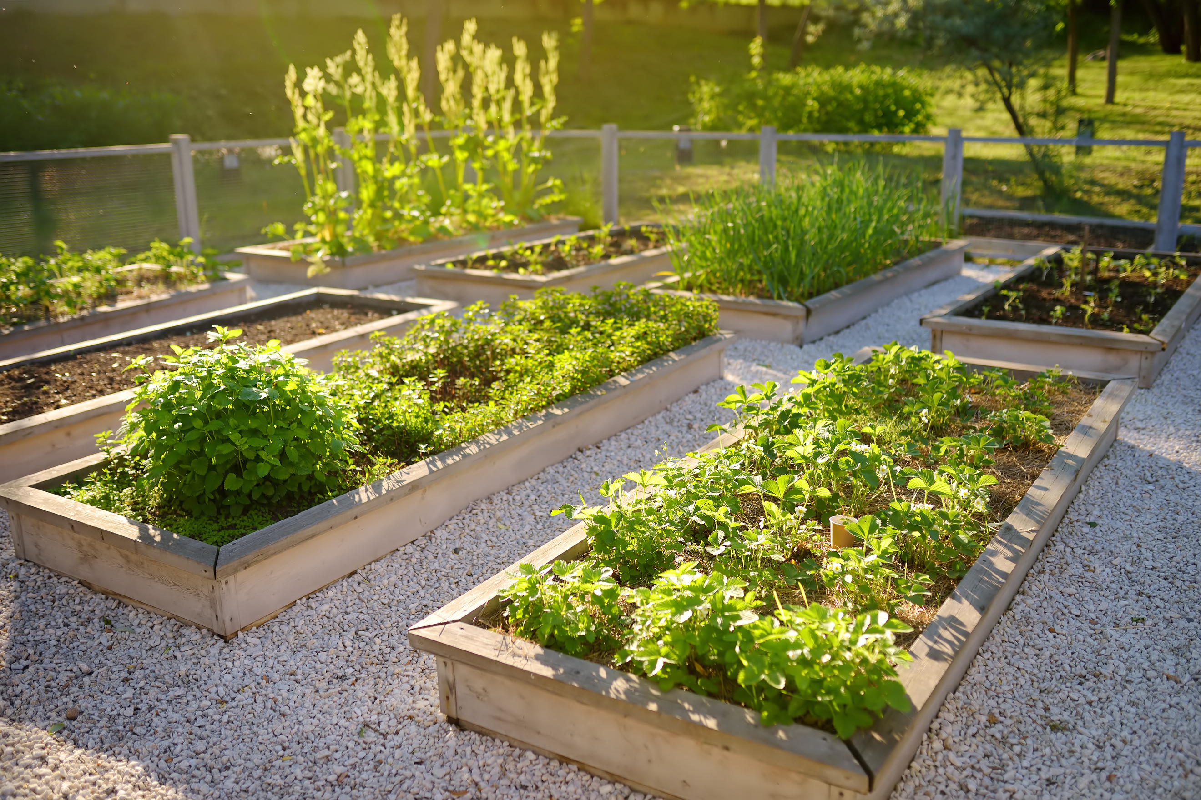

GARDEN
Revolution
NEWSLETTER
xdrfirefly.substack.com

Slide 20
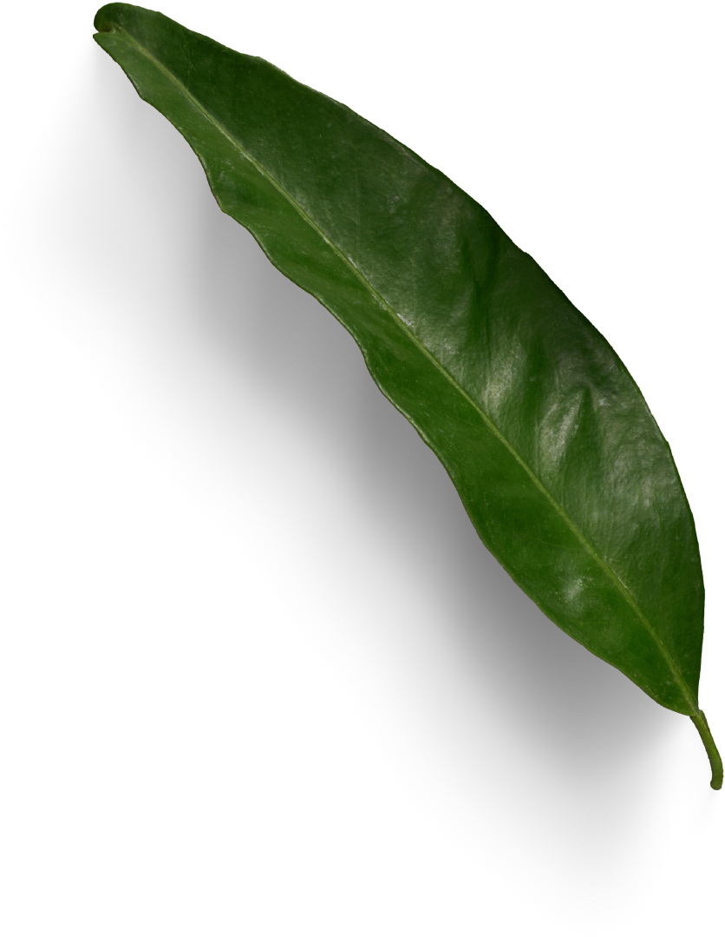




TUESDAY
GARDEN
9PM ET
Revolution
DLIVE.TV/XDRFIREFLY
KICK.COM/XDRFIREFLY
RUMBLE.COM/C/XDRFIREFLY

