Slide 1
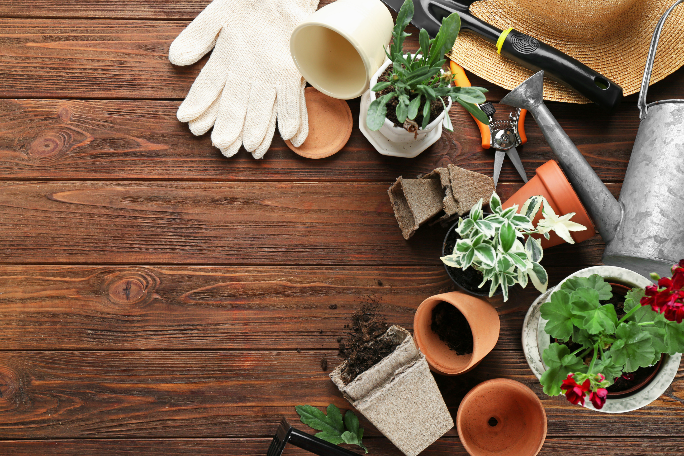

GARDEN
Revolution
BIOCHAR

Slide 2
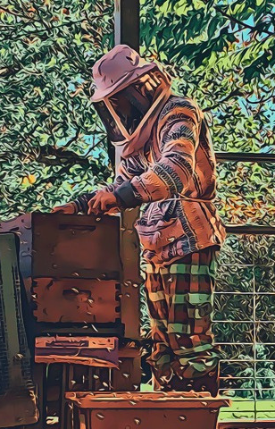
I'm a Master Gardener, Gardening Life Coach, and a Farmer/Rancher in Appalachia. With a passion for sustainable living and over a decade of experience, I've dedicated my life to enhancing ecological awareness and community empowerment. Join me in exploring how we can create a more sustainable future together.
  Bee Keeping
  Herbalism
  Wildcrafting
  Foraging
  Animals Husbandry
  Master Gardener (VA / WV)
  Master Permaculturalist
  Gardening Coaching
  25+ Years Raising Chickens
  Alchemist
  Life Navigation Coach
  Healer
MASTER
PERMACULTURALIST
MASTER
GARDENER

Slide 3






Biochar
What is it!
Use it
Make it.
What is this magical sub straight, where does it come from and why should I put it in my garden.
How do I enhance my garden, is it hard to use? What are the dangers?
Where do I get my hands on this soil magic? Wait, I can make it myself, in a few easy steps?

Slide 4



El Dorado
the story of a fantastic civilization that lived in the Amazon jungle before the Europeans got there but that had always been a problem for people because the soil in the Amazon is so bad that there was no way it could have grown enough food to feed this this population that had lived there
They began to find areas of rich soil some places they were just small an acre two acres same places they're well over a hundred acres that shared two characteristics one of those were very dark dark in color and the second was they were obviously man-made

Slide 5


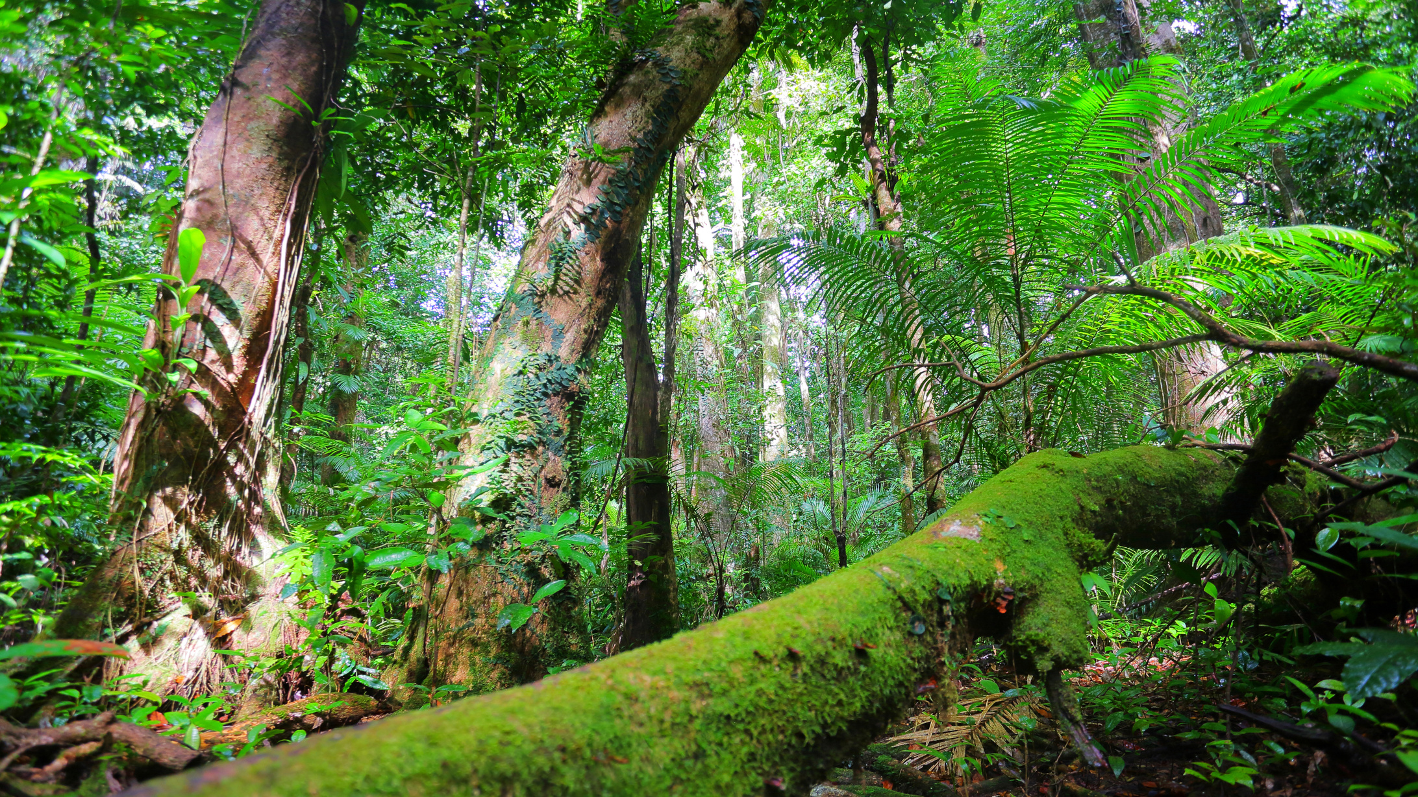


Amazon Soil
Terra preta is a complex blend of various organic and inorganic components, meticulously crafted through human ingenuity. It is typically composed of a combination of charcoal, pottery shards, bone fragments, manure, plant residues, and other organic matter. The mixture is carefully layered and enriched, allowing for a highly fertile and resilient soil structure.

Slide 6
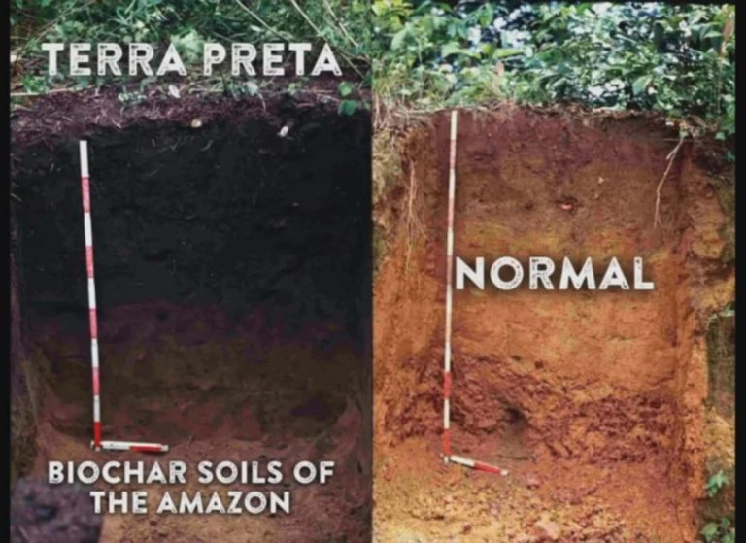




Slide 7


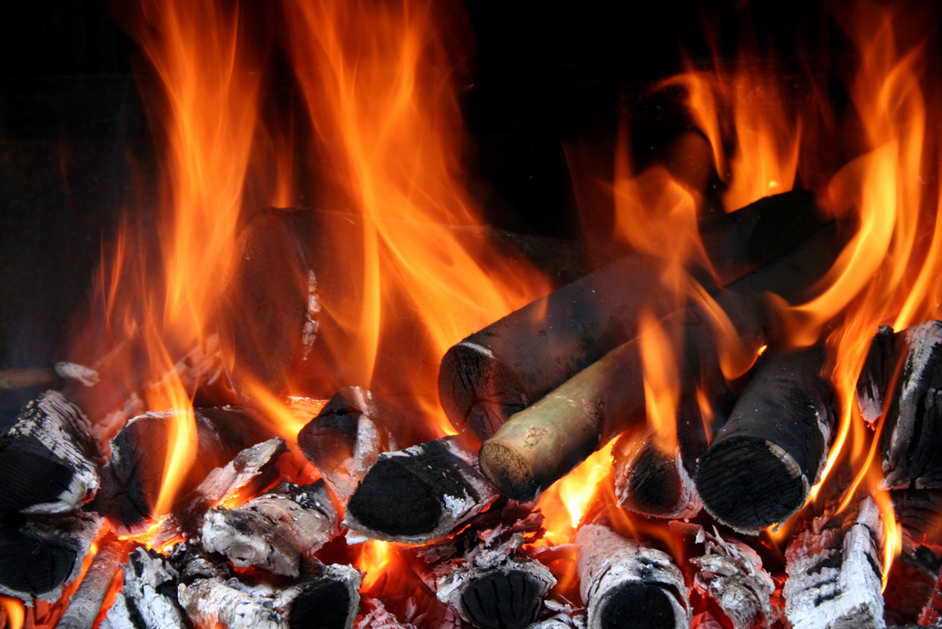

Biochar
Biochar is essentially organic material—such as wood, manure, or leaves that has been transformed through pyrolysis, to be a charcoal.
Pyrolysis
simply means you heat up organic material in the absence of air and when you do that all the volatile gassy parts are driven off and what's left behind is a solid material that is essentially pure carbon

Slide 8

90%
Increase in surface area
When you examine wood under a microscope, it appears filled with passageways and channels designed to transport fluids. Remarkably, there is more open space than solid material. When wood or other organic materials are converted into charcoal, these channels become pores in the charcoal's structure, significantly increasing its surface area. For instance, a single gram of charcoal, roughly the size of a pencil eraser, boasts about 9,000 square feet of surface area.

Slide 9
reasons why it’s so fertile
Charcoal Amendment:
Improved Soil Structure
Microbial Activity
Nutrient Retention
Charcoal not only provides a stable carbon source but also helps with moisture retention, adsorption of nutrients, and microbial habitat enhancement.
Has better soil structure than surrounding soils. This improved structure enhances aeration and water retention, making it more suitable for plant growth.
Conducive to beneficial microbial activity. These microorganisms help break down organic matter and release nutrients in a form that plants can readily absorb.
Has a high cation exchange capacity, meaning it can hold and exchange essential nutrients with plant roots. This property helps maintain nutrient availability for crops.

Slide 10

Why it Sucks
If you put raw biochar in your soil, it will take up water and nutrients from the soil until it is full. This can take anywhere from 3 to 6 months. During this time, the plant's roots are competing with biochar and it can be detrimental to plant growth. We call this the biochar lag period.

Slide 11
It also really sucks
Once the 'sponge' is full of water and nutrients, it is potentially a safe home for beneficial soil microbes. The walls of the biochar protect against attack. The 'sponge' has lots of areas full of nutrients. The microbes live in and close to the biochar. forming symbiotic relationships with plant roots and exchanging nutrients (NPKs) for sugar (which the plants make via photosynthesis).

Slide 12
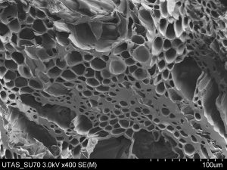
Microorganisms
  Ecological Footprint
It seems the micro-pores in biochar provide a home for a starting culture of beneficial bacteria and fungi. Mycorrhizal fungi are proven to work in symbiosis with plant roots. The fungi supply nutrients to the plants and receive sugars from the plants in return.

Slide 13

The Environment
  CO2
Biochar locks up carbon that would be released quickly by normal burning or slowly by woody materials rotting down. In natural eco-systems, however, the CO2 released by rotting wood would be taken in by the growth of new plants and trees.
German study in 2009 concluded that converting 10% of all their waste plant materials to biochar would actually only sequester 1.6% of their carbon.

Slide 14


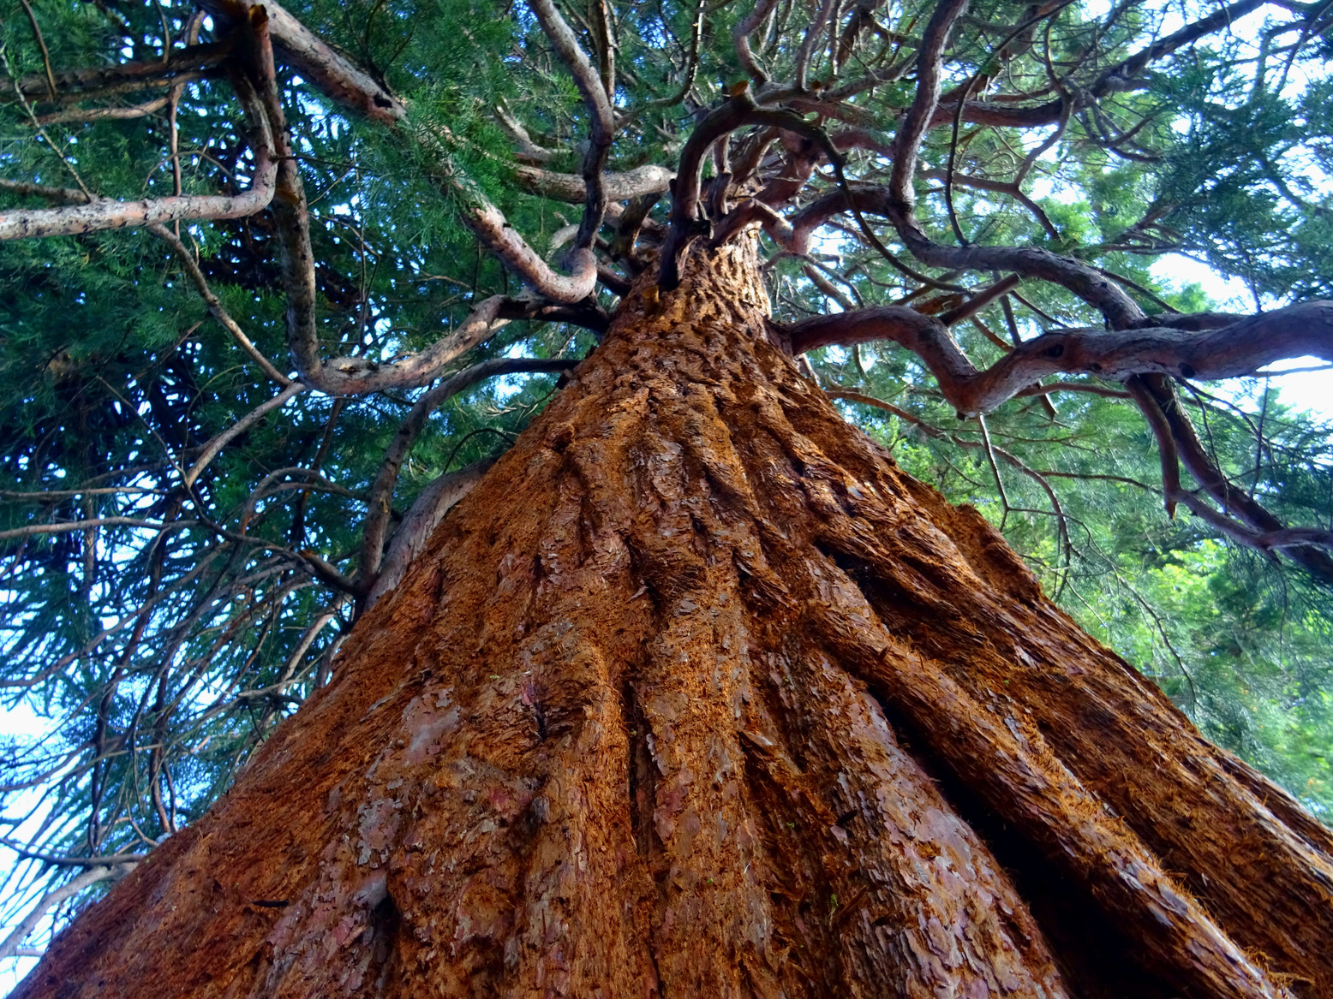

Stored Solar Energy
Scaled able
Carbon Negative

Slide 15
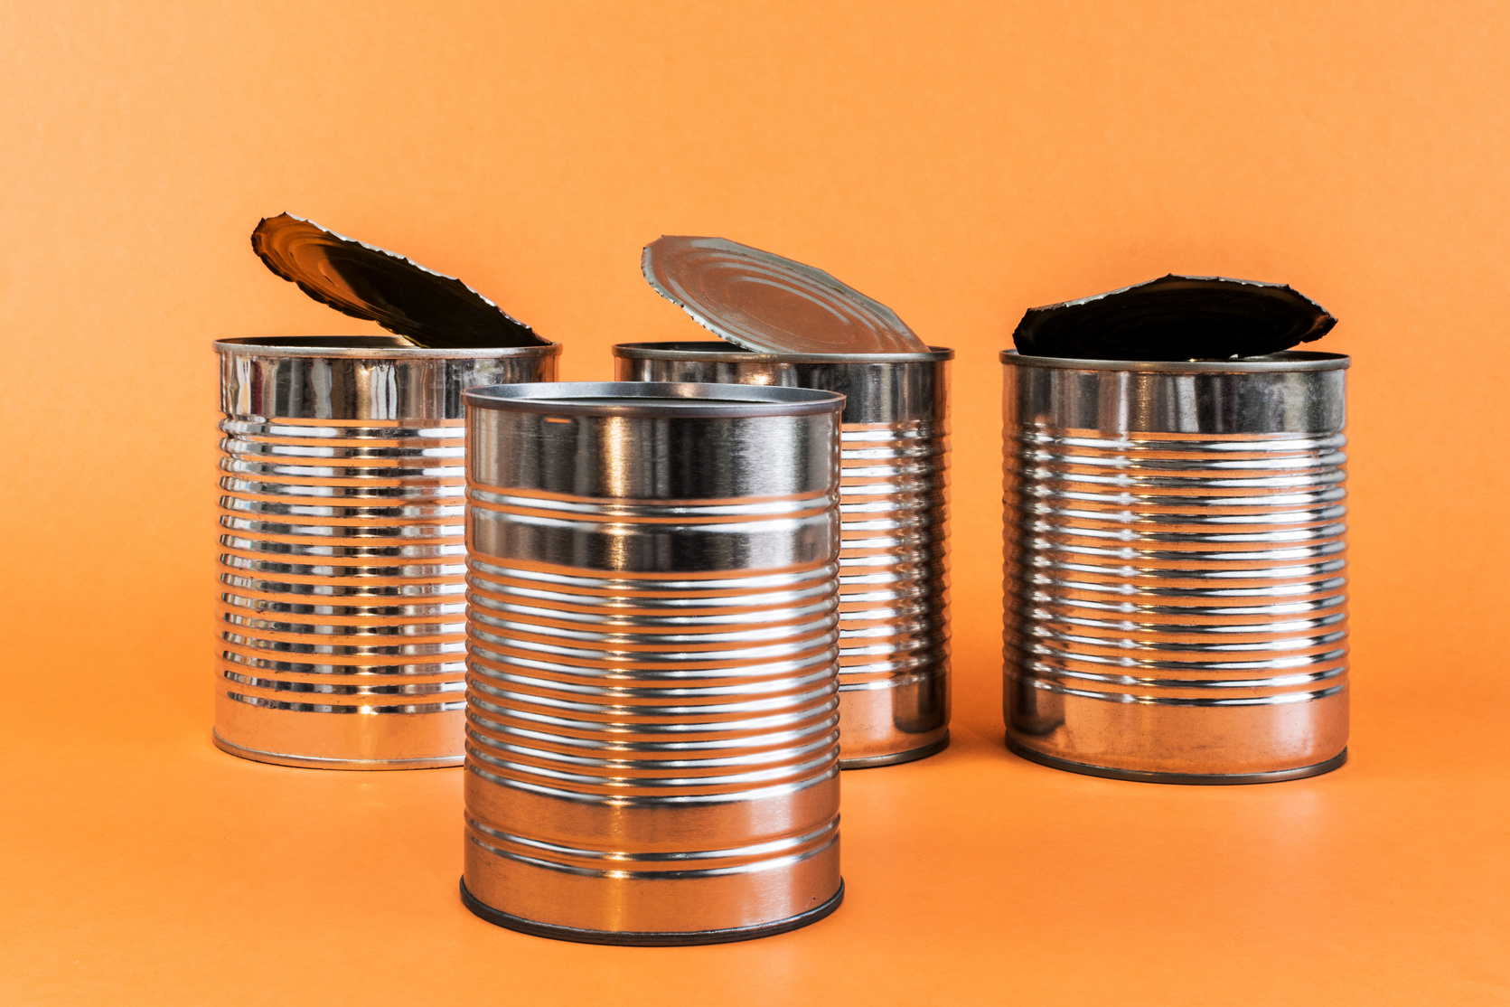
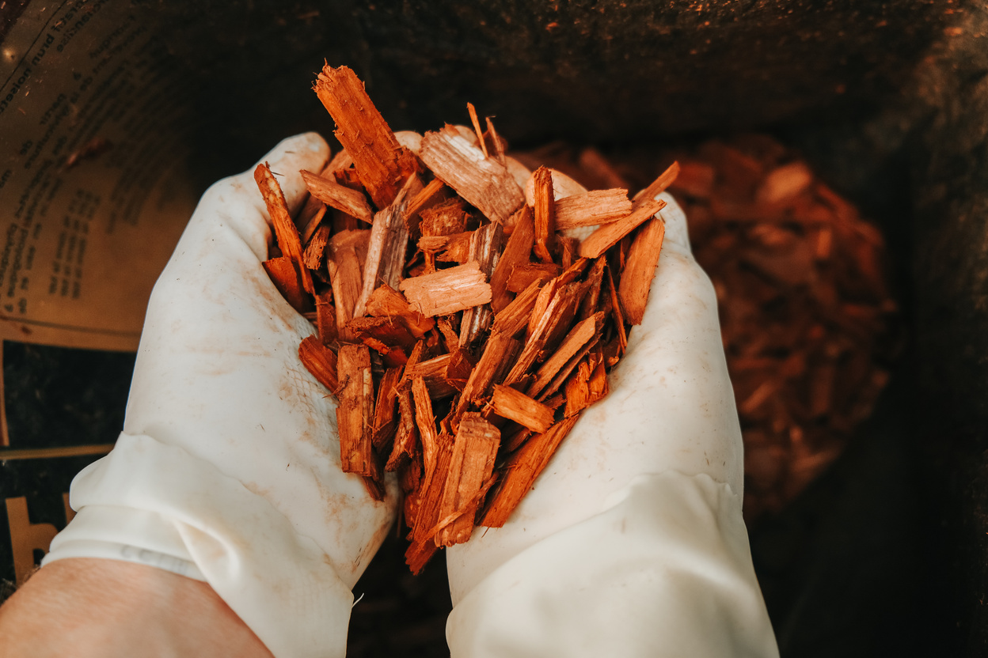

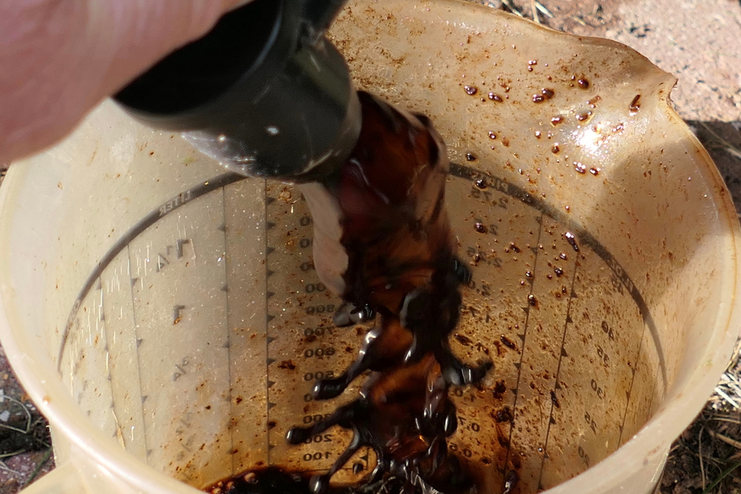
What you need
Can
Organic Material
Fire
Swamp Juice

Slide 16


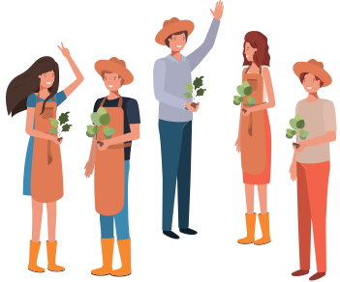

WHERE
TO CONTINUE LEARNING
Local Gardening Clubs: These clubs are like gold mines of knowledge and experience. You get to connect with folks who've been tilling and toiling, and who know the local soil and climate like the back of their hand. Plus, it's a wonderful way to build friendships rooted in a shared love for gardening.
Online Forums and Groups: These virtual communities are amazing for getting speedy answers to your gardening queries, sharing the joys of your garden's progress, and even finding humor in the occasional hiccups. It's a space where you can feel connected with fellow garden enthusiasts from all over the globe, regardless of where you are

Slide 17


xDoc’s IRL Class
Sustainable Garden Series at Craft Memorial Library: And here's something special for you – I personally teach classes once a month at the Craft Memorial Library in Bluefield, WV, as part of the Sustainable Garden Series. It's a fantastic opportunity to learn, share, and grow together in our understanding of sustainable gardening practices.
mavisfarmacy.com

Slide 18
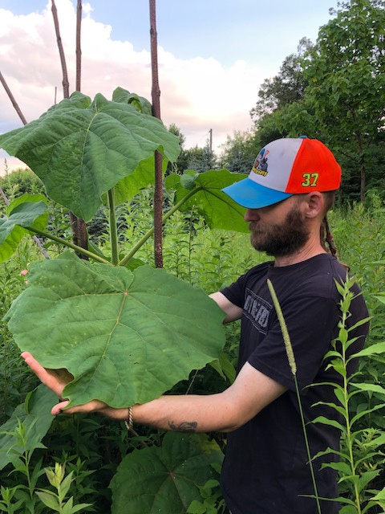
xDoc’s Online Class
Tailored Learning Experience: Alongside the lively discussions on our Discord channel, I also offer private gardening lessons online. These sessions are designed to cater specifically to your gardening interests and challenges. Whether you're a beginner needing foundational advice or an experienced gardener facing unique obstacles, these lessons provide personalized guidance to ensure your garden thrives.
Get in Touch for Customized Guidance: Interested in taking your gardening skills to the next level with some personalized coaching? Feel free to reach out to me at MavisFarmacy@gmail.com. I'll be more than happy to work with you one-on-one, helping you navigate the joys and challenges of gardening in a way that’s customized just for you.
www.mavisfarmacy.com

Slide 19

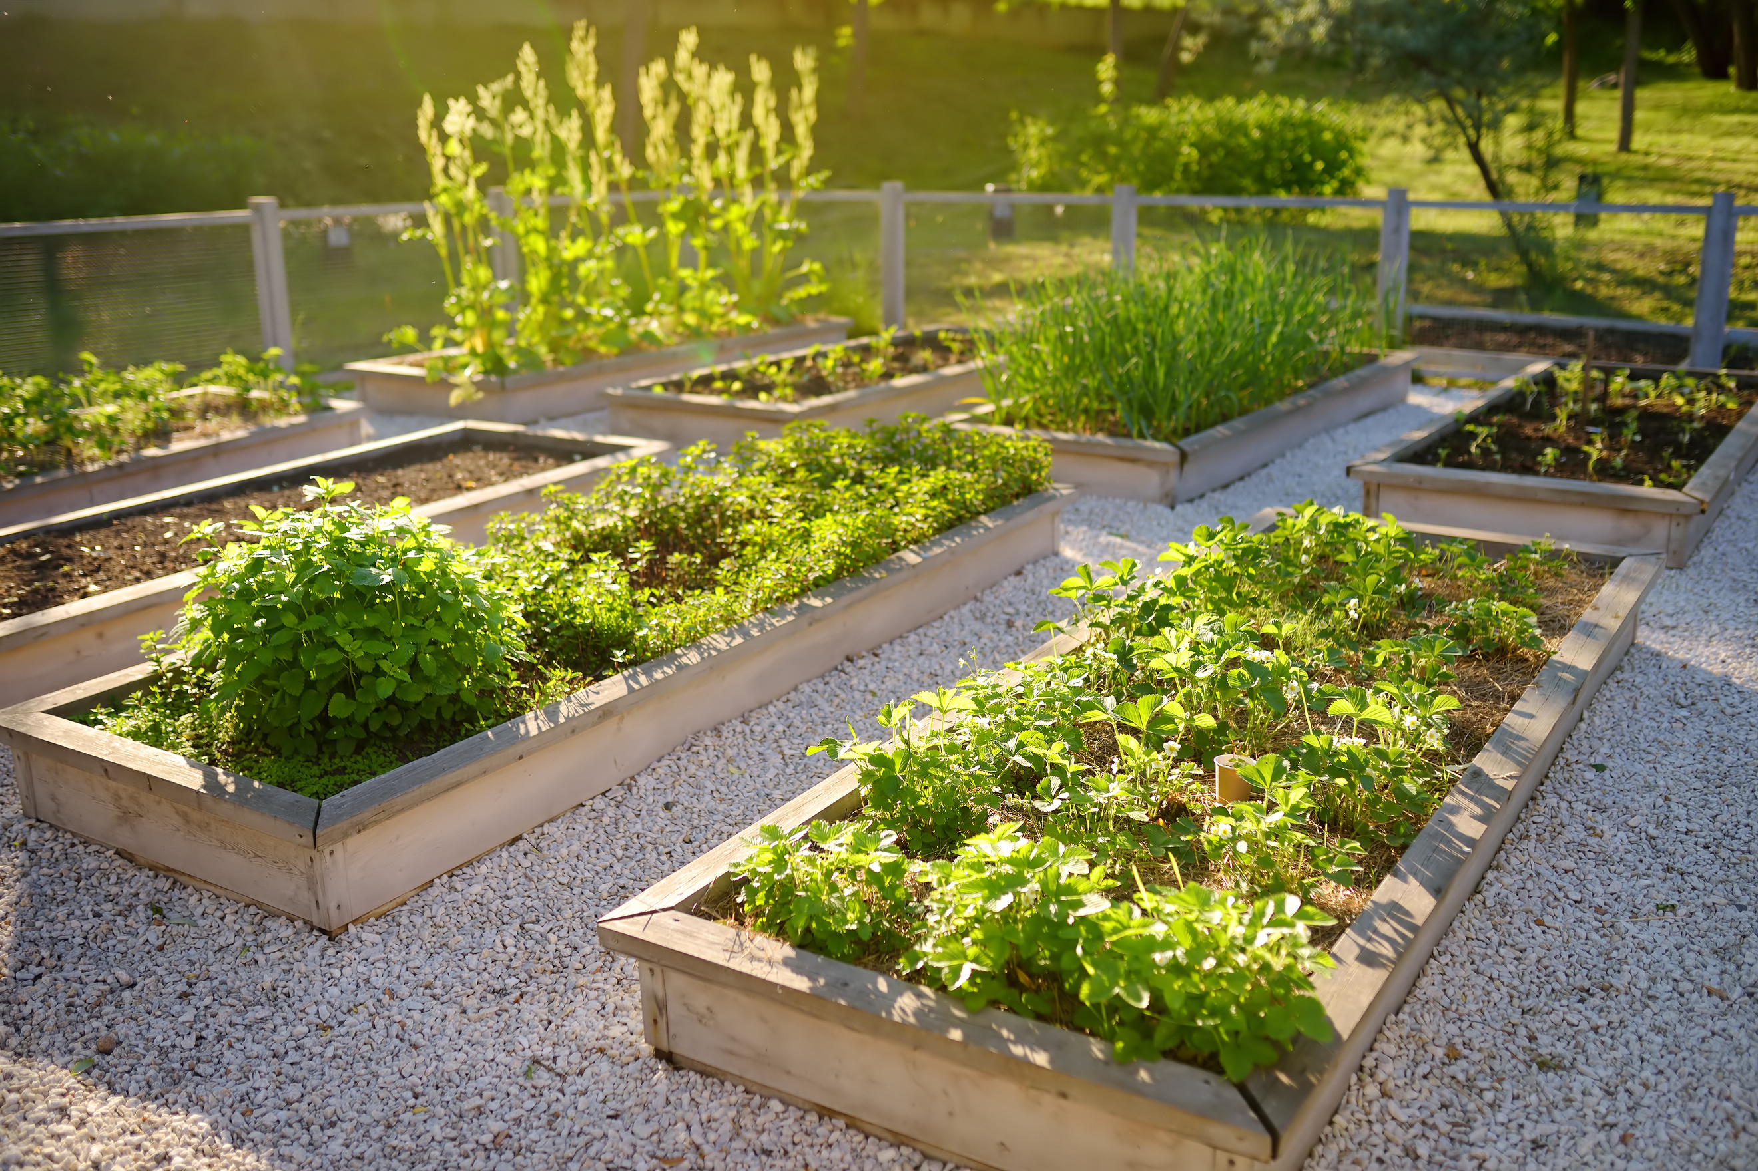

GARDEN
Revolution
NEWSLETTER
xdrfirefly.substack.com

Slide 20
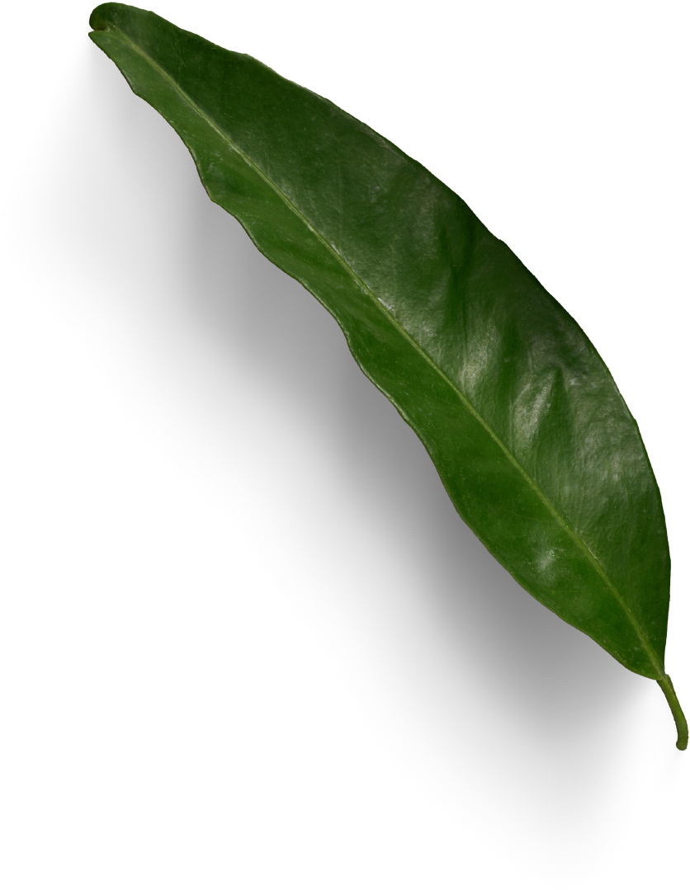




TUESDAY
GARDEN
9PM ET
Revolution
DLIVE.TV/XDRFIREFLY
KICK.COM/XDRFIREFLY
RUMBLE.COM/C/XDRFIREFLY

